Slide 1

Awarely
Personalized Security Training That Clicks.
Hackathon Submission | [Your Team Members' Names]

Slide 2

The Problem: The Human Firewall is Broken
Generic Content
Security Fatigue
"One-size-fits-all" training is irrelevant, leading to widespread employee disengagement.
Constant, non-specific warnings cause employees to tune out real threats.
A Compliant, Yet Vulnerable Workforce
Companies check the compliance box, but their employees remain their biggest vulnerability.

Slide 3
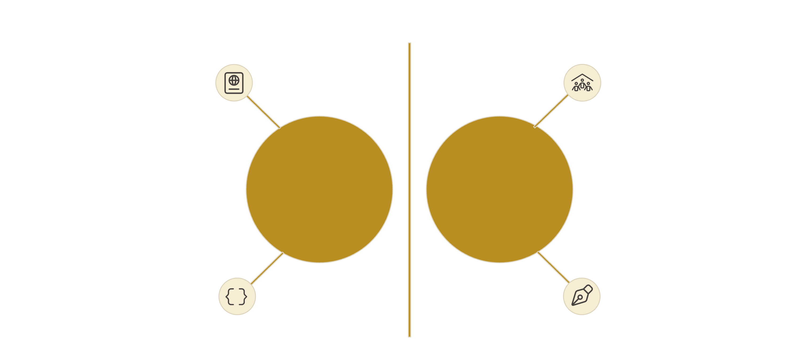




Our Solution: Introducing Awarely
Generic Security Training
HR Manager
Before
After
Developer
Salesperson
We deliver the right training, to the right person, at the right time.

Slide 4



The Innovation: From Passive Compliance to Active Defense
From Generic to Hyper-Relevant
From Passive to Interactive
From A Chore to a Skill
Our platform transforms security training from an annual compliance task into an engaging, continuous skill-building experience.
Instead of generic videos, Awarely uses role-based onboarding to deliver training that mirrors an employee's actual daily workflow and threat landscape.
We replace boring lectures with interactive simulations of real-world threats, dramatically improving knowledge retention and practical skills.

Slide 5
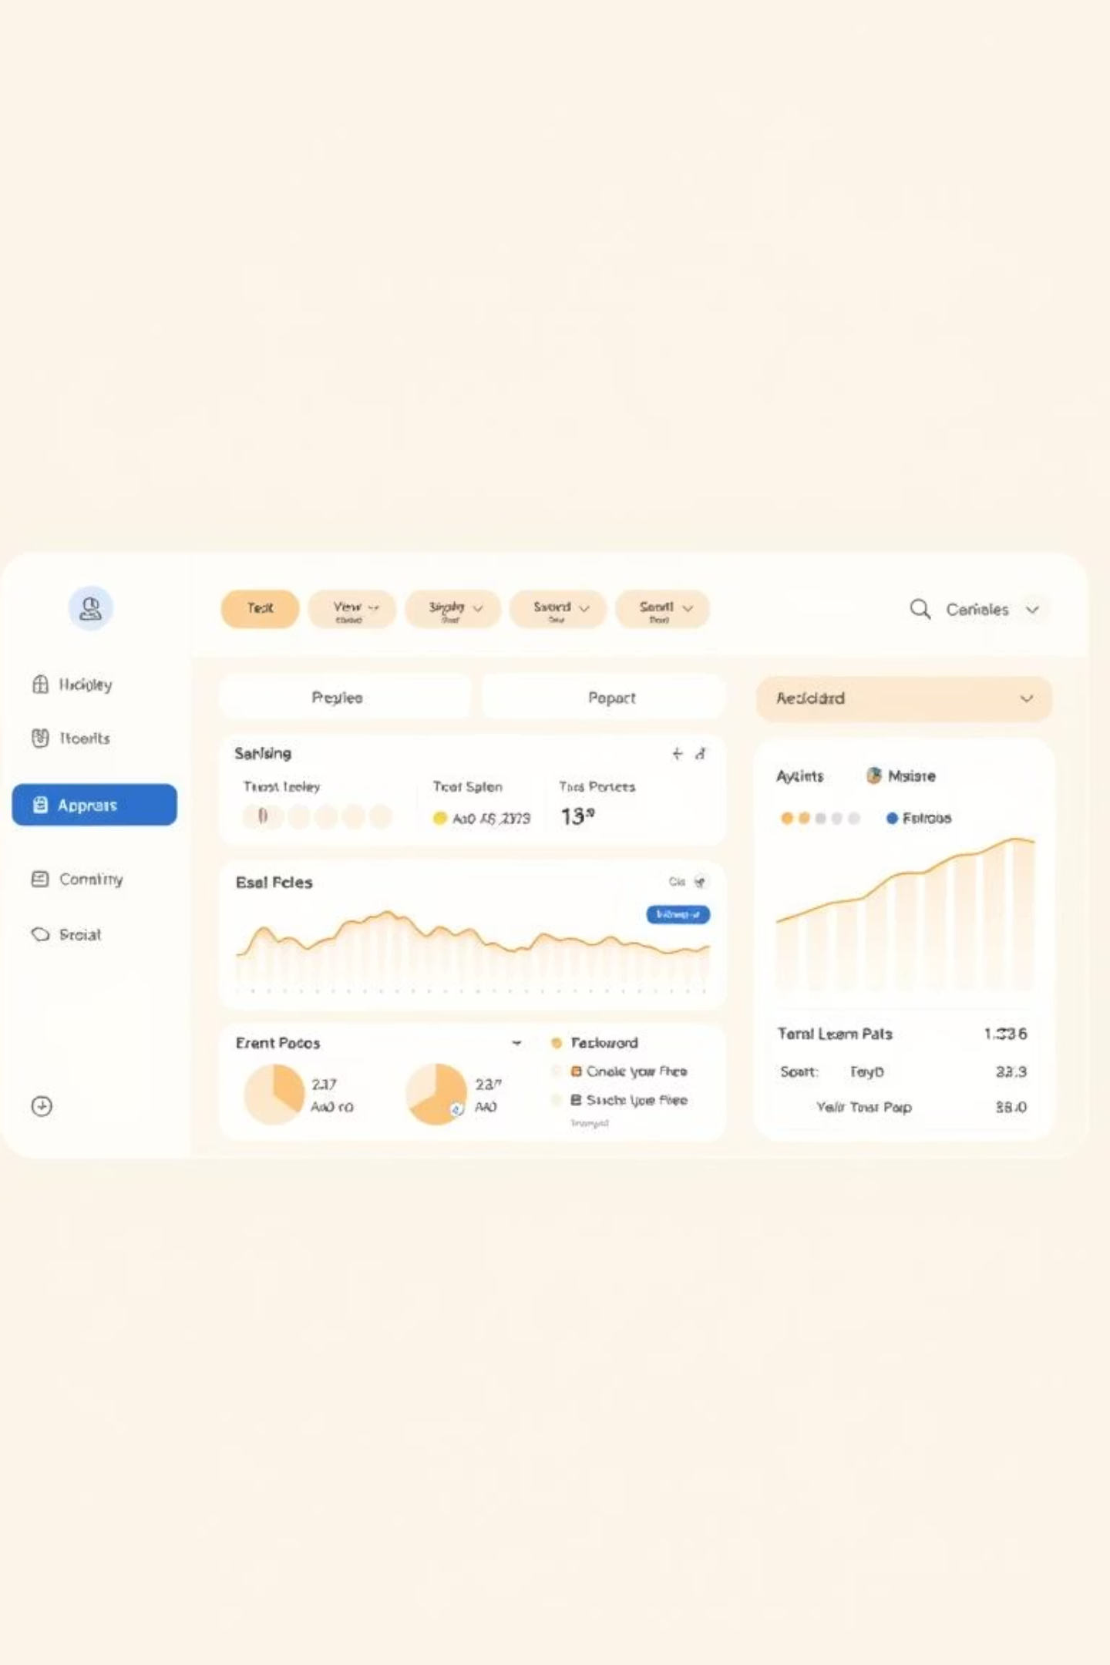
Designed for Engagement and Effectiveness
Role-Based Onboarding
Users select their job role upon signup for an instantly tailored and relevant learning path. No wasted time.
Personalized Dashboard
A clean, clutter-free view of learning modules and progress relevant only to the user's specific role.
Interactive Simulations
Realistic, hands-on scenarios (e.g., "Spot the Phish") that make learning sticky and effective.

Slide 6
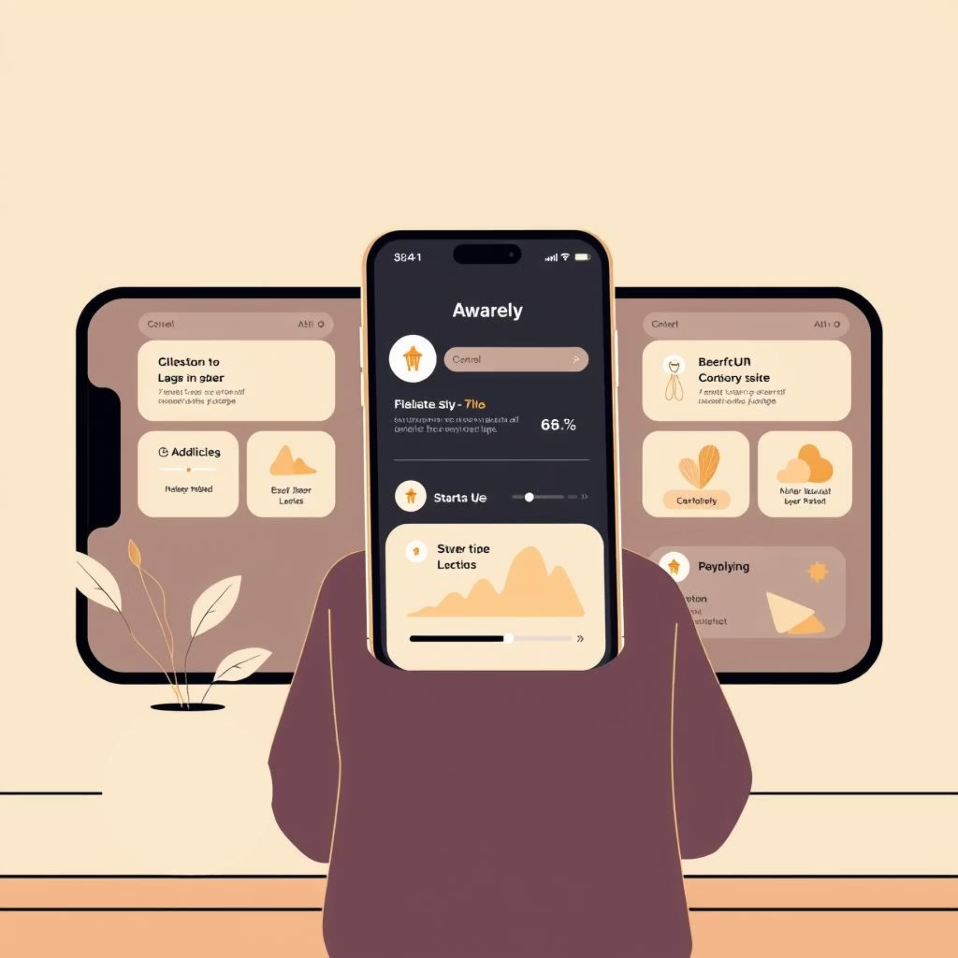

Application Demo
Demonstrated Personas:
HR Manager: Navigating modules on PII protection & resume-based malware.
Software Developer: Engaging with simulations on API key security & GitHub phishing.
Documentation & Code:
Our repository is fully documented with a clear README.md, setup instructions, and commented code.
GitHub Repository:
[Link to your GitHub Repository]

Slide 7

Robust, Modern, and Scalable Architecture
React (Vite)
REST API (JSON)
Spring Boot 3
MySQL (JDBC)
Our Technology Stack
Frontend: React (with Vite) for a blazing-fast, modern, and responsive user experience.
Backend: Spring Boot 3 for powerful, secure, and maintainable business logic using a proven enterprise-grade framework.
Database: MySQL for reliable, structured, and scalable data storage.
Architecture: A decoupled three-tier architecture ensures maintainability and the ability to scale components independently.

Slide 8

Security is Not an Afterthought—It's Our Foundation
Core Security Measures
Authentication & Authorization: All API endpoints are secured using Spring Security. We use stateless JWT (JSON Web Tokens) for authentication, ensuring that every request is verified.
Data Protection: Role-based access control is enforced on the backend, preventing users from accessing data or training modules not assigned to them.
Secure Coding Practices: We follow best practices to prevent common vulnerabilities like SQL Injection and Cross-Site Scripting (XSS).

Slide 9





Our Vision: Creating a Culture of Security
Today
Reduce human error risk
Training
Boost employee engagement
Metrics
Measure workforce readiness
Future
Culture of continuous security
Immediate Impact (Today):
Future Roadmap & Scalability (Future):
Dramatically reduces organizational risk from human error.
AI-Powered Threat Modeling: Automatically generate new training modules based on emerging, real-world threats.
Boosts employee engagement with security protocols.
Provides measurable proof of a more skilled and prepared workforce.
Enterprise Analytics Dashboard: Provide admins with a high-level view of organizational risk areas and employee progress.
Platform Integrations: Seamlessly connect with tools like Slack, Microsoft Teams, and common HRIS platforms.

Slide 10

Opportunities for Improvement
Practice Your Pitch:
The content is now tightly aligned with the criteria. The next step is to practice delivering it. Ensure you speak to each point clearly and confidently.
Visuals Matter:
For each slide, try to find clean, modern icons and graphics that reinforce the message. A well-designed presentation can significantly boost your score in the "Presentation" category.

